Slide 1
Static Timing Analysis
Sci.D.Professor Vazgen Melikyan
Synopsys Armenia Educational Department

Slide 2
CONFIDENTIAL INFORMATION
The information contained in this presentation is the confidential and proprietary information of Synopsys. You are not permitted to disseminate or use any of the information provided to you in this presentation outside of Synopsys without prior written authorization.
IMPORTANT NOTICE
In the event information in this presentation reflects Synopsys’ future plans, such plans are as of the date of this presentation and are subject to change. Synopsys is not obligated to update this presentation or develop the products with the features and functionality discussed in this presentation. Additionally, Synopsys’ services and products may only be offered and purchased pursuant to an authorized quote and purchase order or a mutually agreed upon written contract with Synopsys.

Slide 3
Course Overview
STA Concepts
1 lecture
Delay Modeling
1 lecture
Interconnect Parasitics
1 lecture
Delay Calculation
1 lecture
Configuring the STA Environment
1 lecture
Timing Checks
1 lecture
Crosstalk and Noise
1 lecture

Slide 4
2. Delay Modeling

Slide 5
Path Delay: Basic Approach
t=1n
a
d
b
t=2n
t=0.5n
e
c
y
t_{delay}=3.5n

Slide 6
Delay Dependencies
t_{rise} 10ps – 120ps
C_{load} 10fF – 50 fF
t_{d}
C_{L}
t_{d}
t_{rise}
t_{d} ~ C_{L}
C_{L}
t_{d} ~ t_{rise}
t_{rise}

Slide 7
Path Delay Calculation
Specific PVT
t₁=f(t₂,c₁)
t₃=f(t_{2e},c₃)
a
d
t_{2a}
t_{2d}
b
t_{fy}
t_{2b}
C₁
t_{2e}
e
y
c
C₃
t_{2c}
C₂
t₂=f(t_{2d},t_{2c},c₂)
t_{total}= f(t_{2a},t_{2b},t_{2c},C₁,C₂,C₃)

Slide 8
Operating Conditions
Process: TT, FF, SS, etc.
Voltage: ∓10%
Temperature: -40 -125⁰C
t_{d}
C_{L}
P:SS
V:0.9
T:-40
t_{rise}
t_{d} ~ Process Variations
t_{d} ~ Voltage
t_{d} ~ Temperature
P:TT
V:1.2
T:125

Slide 9
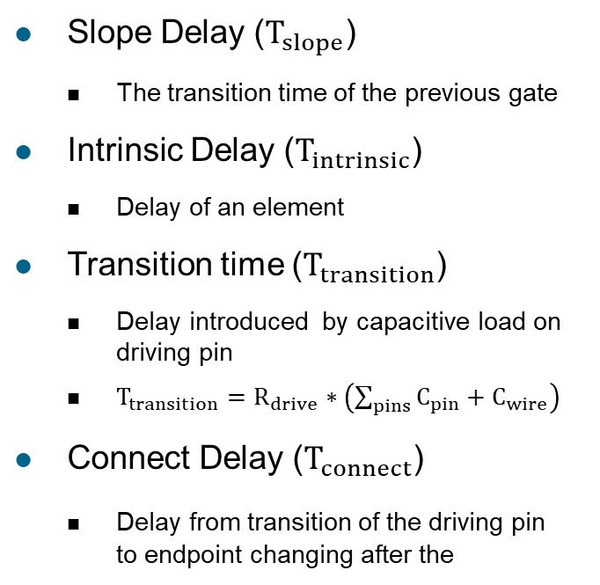
Linear Delay Model
$$T_{total}=T_{slope}+T_{intrinsic}+T_{transition}+T_{connect}$$
Slope Delay ($T_{slope}$)
The transition time of the previous gate
Intrinsic Delay ($T_{intrinsic}$)
Delay of an element
Transition time ($T_{transition}$)
Delay introduced by capacitive load on driving pin
$T_{transition}=R_{drive}∗\left(\sum_{pins}{C_{pin}+C_{wire}}\right)$
Connect Delay ($T_{connect}$)
Delay from transition of the driving pin to endpoint changing after the
T_{connect}
B
T_{slope}
T_{intrinsic}
D
A
C
T_{transition}

Slide 10


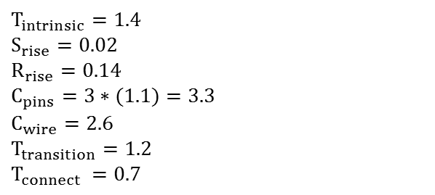
Delay Calculation (Linear) Example
1.2 ns
C_{wire}= 2.6

Slide 11
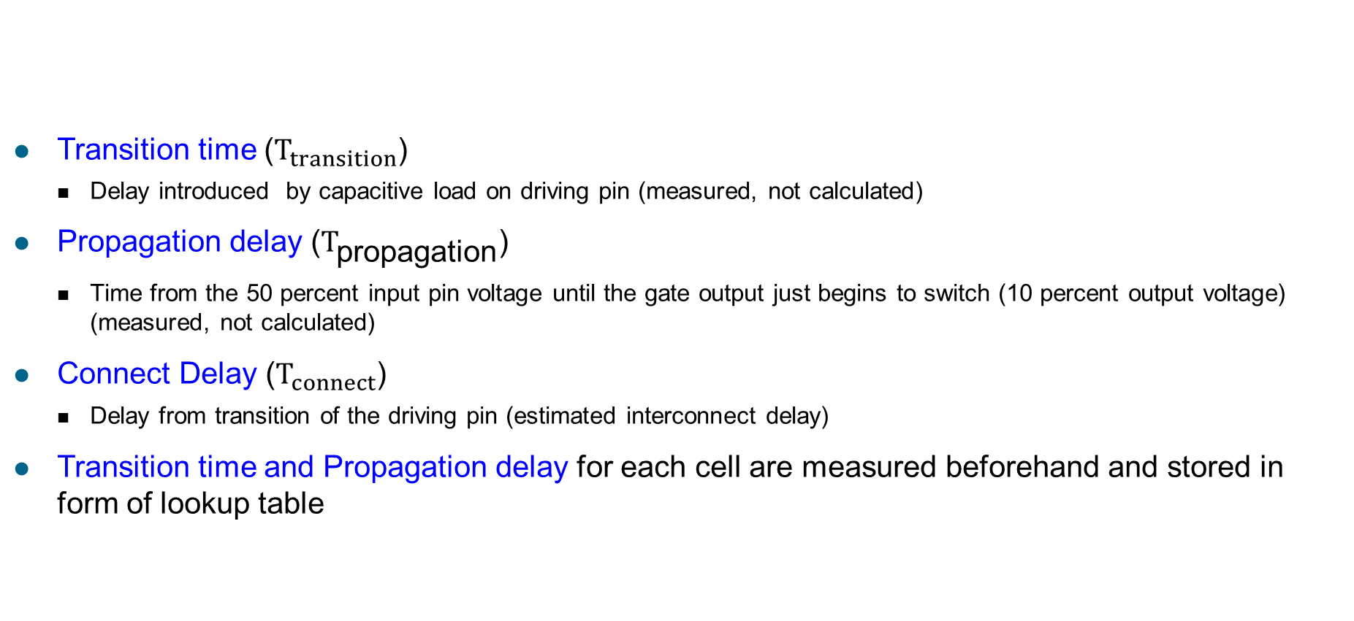
Nonlinear Delay Model
Transition time ($T_{transition}$)
Delay introduced by capacitive load on driving pin (measured, not calculated)
Propagation delay ($T_{\text{propagation}}$)
Time from the 50 percent input pin voltage until the gate output just begins to switch (10 percent output voltage) (measured, not calculated)
Connect Delay ($T_{connect}$)
Delay from transition of the driving pin (estimated interconnect delay)
Transition time and Propagation delay for each cell are measured beforehand and stored in form of lookup table
T_{total} = T_{propagation} + T_{transition} + T_{connect}

Slide 12
Nonlinear Delay Calculation Example
G₁
G₃
G₂
T
C_{total}
rise
P
T
fall
fall
net n1

Slide 13
Two-dimensional Interpolation
z
Fall Propagation Delay
110.1
Output
Capacitance
10.2
30.8
58.7
99.9
151.6
y
0.20
0.34
Input
Transition
Time
0.56
0.72
1.23
x

Slide 14
Non Linear Delay Model (NLDM)
cell
_
rise
or
cell
_
fall
Input slew
table
0
.
7
0.25 | 0.27 | 0.31 | 0.33 | 0.4
0.26 | 0.28 | 0.29 | 0.31 | 0.35
0.35 | 0.37 | 0.39 | 0.41 | 0.45
0.40 | 0.41 | 0.43 | 0.48 | 0.51
0
.
5
0
.
2
Input slew
0
.
1
Output cap
.
023
.
047
.
065
.
078
.
091
output cap
Delay/Power are measured as function of input slew and output cap
Linear Delay model:
Delay = Intrinsic Delay + Slope_factor * Load(Cap)

Slide 15

Composite Current Source Model (CCS)
Network model
C1
C2
The driver model uses a time-varying current source.
The receiver model consists of 2 different capacitors. The first one is used as load up to the input delay threshold. A second capacitance value is used when the input waveform reaches the threshold value.
CCS models are frequently used in advanced technology nodes.

Slide 16
Synopsys Liberty Format (.lib)
library (Digital_Std_Lib) {
technology (cmos);
delay_model : table_lookup;
cell(AND2) {
area : 2;
pin(A) {
direction : input;
}
pin(B) {
direction : input;
}
pin(Z) {
direction : output;
function : "A*B";
timing() {
related_pin : “A" ;
timing_type : "combinational" ;
cell_rise(…) {
index_1("0.016, 0.032, 0.064”);
index_2("2, 4");
values("1.0020, 1.1280, 3.547 “, \
"1.0080, 1.1310, 3.847 “ );
}
}
} /* end of pin */
} /* end of cell */
} /* end of library*/
Lookup table
 |  | t_{rise}
 |  | 0.016 | 0.032 | 0.064
C_{L} | 2 | 1.0020 | 1.1280 | 3.547
 | 4 | 1.0080 | 1.1310 | 1.1310
t_{d}
C_{L}
t_{rise}
Notes:
16

Slide 17
Cell Timing Data
library(){
lu_table_template ("del_1_7_7") {
variable_1 : "input_net_transition";
index_1("1, 2, 3, 4, 5, 6, 7");
variable_2 : "total_output_net_capacitance";
index_2("1, 2, 3, 4, 5, 6, 7");
}
cell (INVX1) {
pin (Y) {
timing () {
related_pin : "A";
timing_type : "combinational";
timing_sense : "negative_unate";
cell_rise ("del_1_7_7") {
index_1("0.016, 0.032, 0.064, 0.128, 0.256, 0.512, 1.024");
index_2("0.1, 0.25, 0.5, 1, 2, 4, 8");
values("0.016861, 0.0179019, 0.0195185, 0.0229259, 0.029658, 0.043145, 0.07712", \
"0.0239648, 0.0255491, 0.0279298, 0.0319930, 0.0387540, 0.0520896, 0.0790211", \
"0.0342118, 0.0366966, 0.0402223, 0.0462823, 0.0558327, 0.0705154, 0.0967339", \
"0.0491695, 0.0524727, 0.0576512, 0.0665647, 0.0810999, 0.1027237, 0.1342571", \
"0.0721332, 0.0765389, 0.0836775, 0.0960890, 0.1171612, 0.1497265, 0.1957640", \
"0.1111560, 0.1164417, 0.1252609, 0.1422002, 0.1712097, 0.2171862, 0.2847010", \
"0.1841131, 0.1901881, 0.2010298, 0.2194395, 0.2555983, 0.3182710, 0.4139452");
}

Slide 18
Cell Types: Sequential Cells
Combinational
Cell output changes with changes at input
Sequential
Cell has memory and output depends on memory and input
B
A
C
Synchronous input
Data
Flip Flop
Output
Clock
Reset
Asynchronous input

Slide 19
Timing Group Names
N | Parameter | Unit | Symbol | Figure | Definition
 | Rise transition time rise_transition | ns | t_{R} |  | The time it takes a driving pin to make a transition from kV_{DD} to (1-k)V_{DD} value. Usually k=0.1 (also possible k=0.2, 0.3, etc)
 | Fall transition time fall_transition | ns | t_{F} |  | The time it takes a driving pin to make a transition from (1‑k)V_{DD} to kV_{DD} value. Usually k=0.1 (also possible k=0.2, 0.3, etc)
 | Propagation delay low-to-high (rise) cell_rise | ns | t_{PLH} (t_{PR}) |  | Time difference between the input signal crossing a 0.5V_{DD} and the output signal crossing its 0.5V_{DD} when the output signal is changing from low to high
4. | Propagation delay high-to-low (Fall) cell_fall | ns | t_{PHL} (t_{PF}) |  | Time difference between the input signal crossing a 0.5V_{DD} and the output signal crossing its 0.5V_{DD} when the output signal is changing from high to low

Slide 20
Combinational Timing Arc Syntax
Combinational timing arc between input A and output Y, with negative dependence, i.e. When A is rising Y is falling and vice-versa
cell (INVX1) {
pin (Y) {
timing () {
related_pin : "A";
timing_type : "combinational";
timing_sense : "negative_unate";
cell_rise ("del_1_7_7") {
index_1("0.016, 0.032, 0.064, 0.128, 0.256, 0.512, 1.024");
index_2("0.1, 0.25, 0.5, 1, 2, 4, 8");
values("0.0168610, 0.0179019, 0.0195185, 0.0229259, 0.0296588, 0.0431451, 0.0702328", \
"0.0239648, 0.0255491, 0.0279298, 0.0319930, 0.0387540, 0.0520896, 0.0790211", \
"0.0342118, 0.0366966, 0.0402223, 0.0462823, 0.0558327, 0.0705154, 0.0967339", \
"0.0491695, 0.0524727, 0.0576512, 0.0665647, 0.0810999, 0.1027237, 0.1342571", \
"0.0721332, 0.0765389, 0.0836775, 0.0960890, 0.1171612, 0.1497265, 0.1957640", \
"0.1111560, 0.1164417, 0.1252609, 0.1422002, 0.1712097, 0.2171862, 0.2847010", \
"0.1841131, 0.1901881, 0.2010298, 0.2194395, 0.2555983, 0.3182710, 0.4139452");
}

Slide 21
Delay Analysis
Calculation of each timing arc’s value cell delay or a net delay
Positive unate timing arc combines rise delays with rise delays and fall delays with fall delays
Negative unate timing arc combines incoming rise delays with local fall delays and vice versa
Non-unate timing arc combines local delay with the worst – case incoming delays logic functions whose output value change cannot be predicted
1
1
1
0

Slide 22
Timing Constraints: Timing Types
Setup/Hold, Recovery/Removal Constraints
N | Parameter | Unit | Symbol | Figure | Definition
1 | Setup time (only for flip-flops or latches) | ns | t_{SU} |  | The minimum period in which the input data to a flip-flop or a latch must be stable before the active edge of the clock occurs
2.. | Hold time (only for flip-flops or latches) | ns | t_{H} |  | The minimum period in which the input data to a flip-flop or a latch must remain stable after the active edge of the clock has occurred
3 | Removal time (only for asynchronous Set or Reset) | ns | t_{REM} |  | The minimum time in which the asynchronous Set or Reset pin to a flip-flop or latch must remain enabled after the active edge of the clock has occurred
4 | Recovery time (only for asynchronous Set or Reset) | ns | t_{REC} |  | The minimum time in which Set or Reset must be held stable after being deasserted before next active edge of the clock occurs
setup_rising
setup_falling
hold_rising
hold_falling
removal_rising,
removal_falling
recovery_rising,
recovery_falling

Slide 23
Hold Timing Example
lu_table_template ("vio_7_7_1") {
variable_1 : "related_pin_transition";
index_1("1, 2, 3, 4, 5, 6, 7");
variable_2 : "constrained_pin_transition";
index_2("1, 2, 3, 4, 5, 6, 7");
}
pin(D) {
timing () {
timing_type : "hold_rising";
related_pin : "CLK";
rise_constraint ("vio_7_7_1") {
index_1("0.016, 0.032, 0.064, 0.128, 0.256, 0.512, 1.024");
index_2("0.016, 0.032, 0.064, 0.128, 0.256, 0.512, 1.024");
values("-0.011, -0.011, -0.014, -0.013, -0.003, 0.025, 0.097", \
"-0.011, -0.011, -0.015, -0.013, -0.003, 0.028, 0.097", \
...
"-0.015, -0.018, -0.033, -0.063, -0.100, -0.128, -0.228");
}
fall_constraint ("vio_7_7_1") {
...
}
}
}

